Slide 1

Logistic Regression-R
S M Amanullah

Slide 2
Objectives
We will work with the advertising data of a marketing agency to develop a machine learning algorithm that predicts if a particular user will click on an advertisement. However, targeting the right audience is still a challenge in online marketing. Spending millions to display the advertisement to the audience that is not likely to buy your products can be costly.
We will see if we can use the other 9 variables to accurately predict the value 'Clicked on Ad' variable.

Slide 3
Count of Variables & Observations
Total variables: 10
Target variable is Clicked.
Variables which were correlated with the target variable:
Time Spent
Age
Avg Income
Internet Usage
Male
Time Period
Ad Topic
Left out variables were not correlated or had very less relation with the Target Variable.

Slide 4
Significant Variables
Time Spent
Age
Avg Income
Internet Usage
Male
Time Period
Ad Topic

Slide 5
Insignificant Variables
Weekday
Month
Visit ID
Year
Country Name
City Code

Slide 6
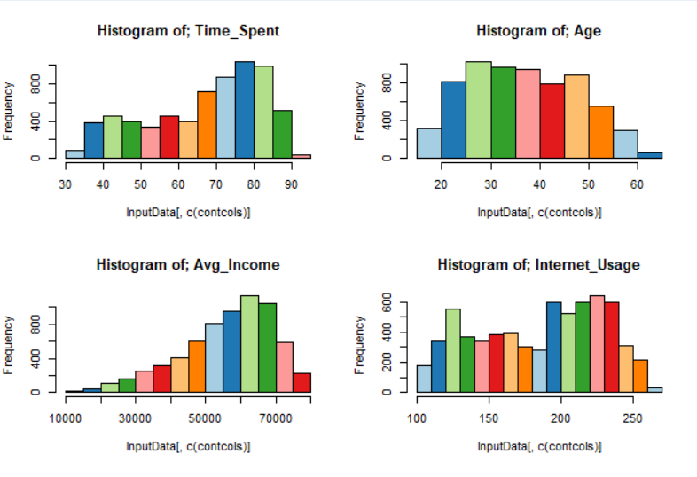
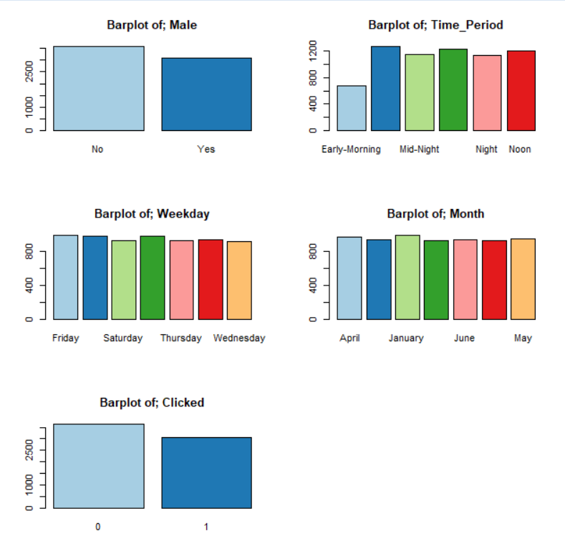
Graphical display of Variables

Slide 7
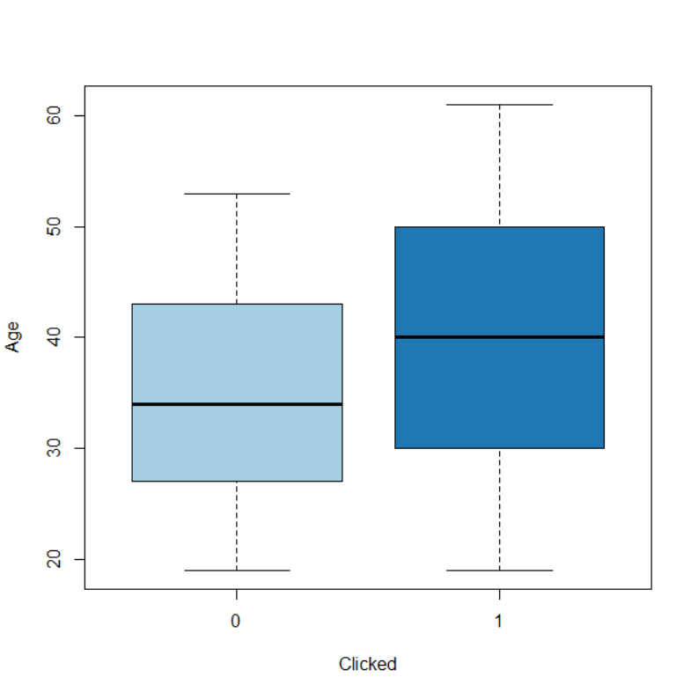
Visual Relationship b/w Target Variable and Predictor Clicked & Age

Slide 8
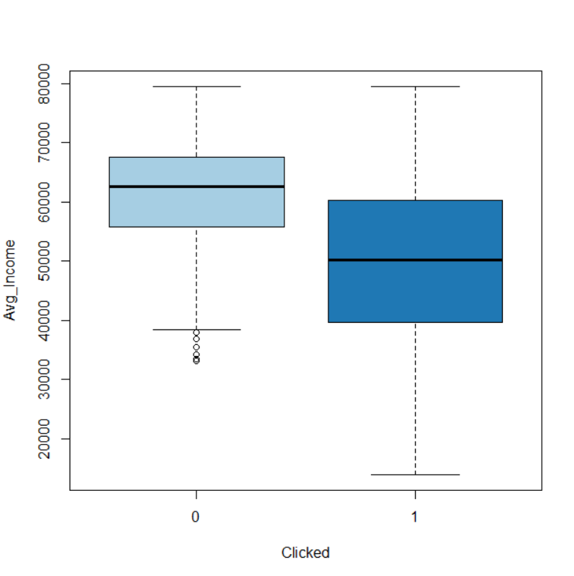
Visual Relationship b/w Target Variable and Predictor Clicked & Avg. Income

Slide 9
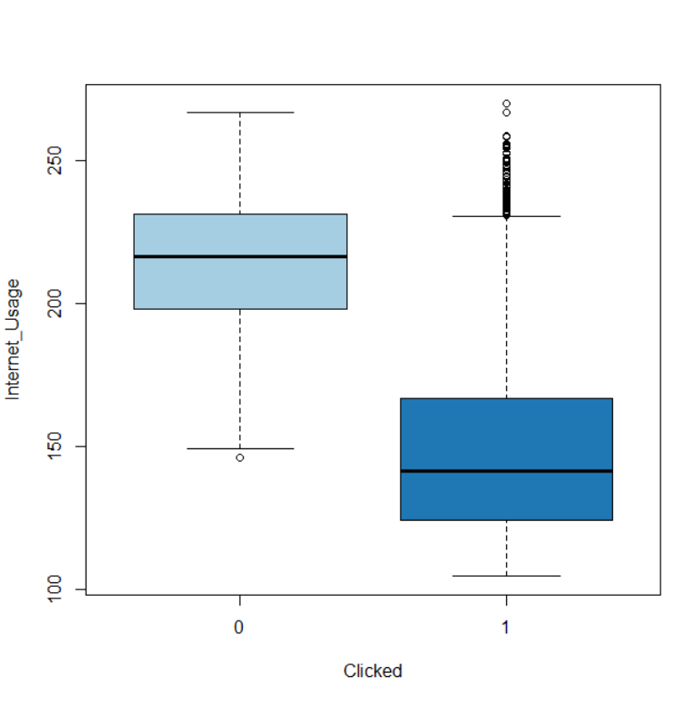
Visual Relationship b/w Target Variable and Predictor Clicked & Internet Usage

Slide 10
Bivariate analysis
Analysis of variance (ANOVA) is a statistical technique that is used to check if the means of two or more groups are significantly different from each other. ANOVA checks the impact of one or more factors by comparing the means of different samples.
Small P-Value--> Variables are correlated (H0 is rejected)
Large P-Value--> Variables are NOT correlated (H0 is accepted)
The Chi-Square Test of Independence determines whether there is an association between categorical variables (i.e., whether the variables are independent or related). It is a nonparametric test. This test is also known as: Chi-Square Test of Association.

Slide 11
Logistic Regression
In statistics, the logistic regression is used to model the probability of a certain class or event existing such as pass/fail, win/lose, alive/dead or healthy/sick. This can be extended to model several classes of events such as determining whether an image contains a cat, dog, lion, etc.
Null deviance: 6427.6 on 4658 degrees of freedom
Residual deviance: 2010.4 on 4619 degrees of freedom
AIC: 2090.4

Slide 12
Results Obtained
Confusion matrices are used to visualize important predictive analytics like recall, specificity, accuracy, and precision. Confusion matrices are useful because they give direct comparisons of values like True Positives, False Positives, True Negatives and False Negatives
Following is the prediction:
Prediction 0 1 0 139 44 1 12 73
Model predicted 0 as 0, 139 times and 0 as 1, 44 times.
Model predicted 1 as 0, 12 times and 1 as 1, 73 times.
The accuracy of the logistic regression model is 0.94 or 94.5%

Slide 13
Business Recommendations
People who spent less time on the website are the one who clicked the ad.
Most of them were male.
People below the age of 50 years, most likely to click on the ad.
People with less internet usage are more likely to click on the ad.
Time frame where people mostly clicked on the ad was either early morning or in the evening and less were on noon.

Slide 14
Thank You!

